Slide 1
Financial Data Science Group Project
Group member:
Deng Qiuyun, Jeriel Wong, Ma Qiyuan, Qian Yutao, Zeng Taili

Slide 2
Project 1

Slide 3
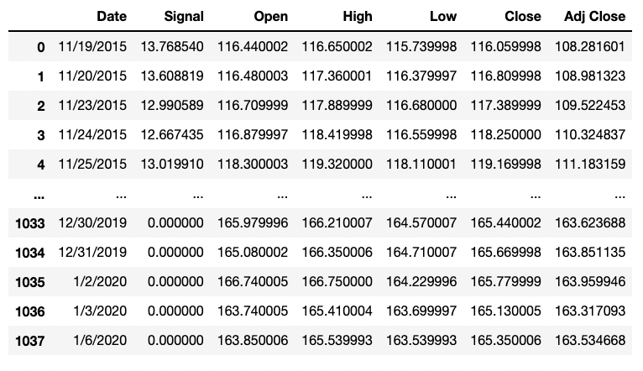
Data Preview

Slide 4
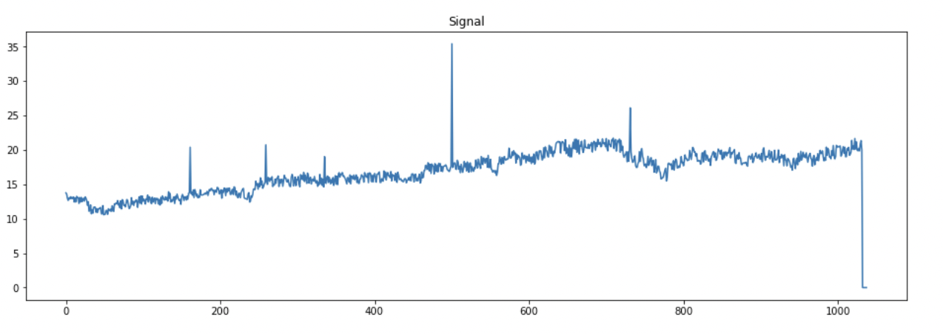
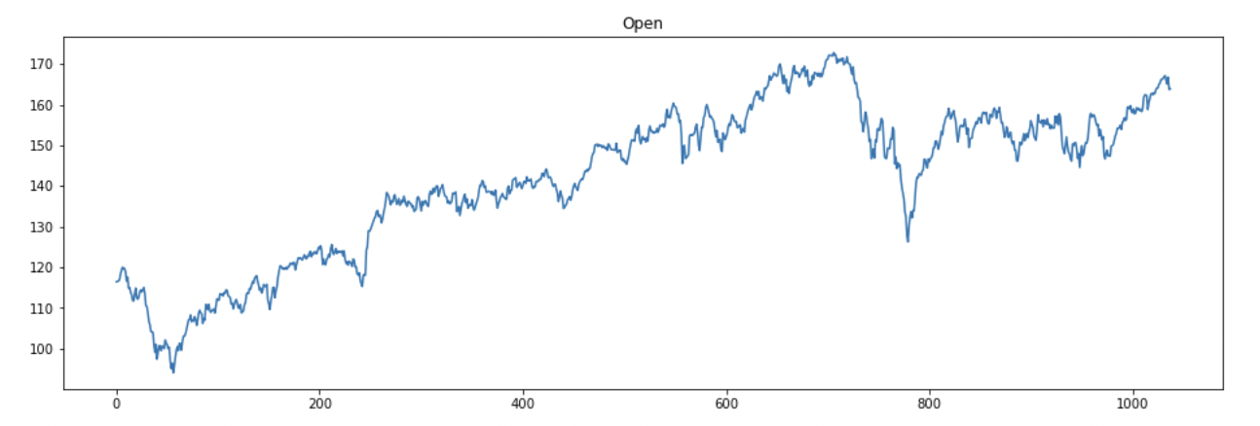

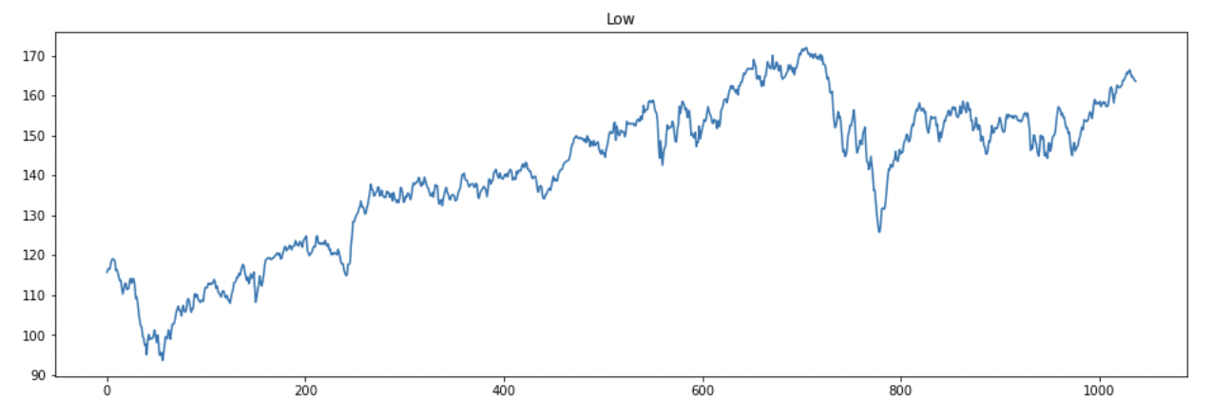
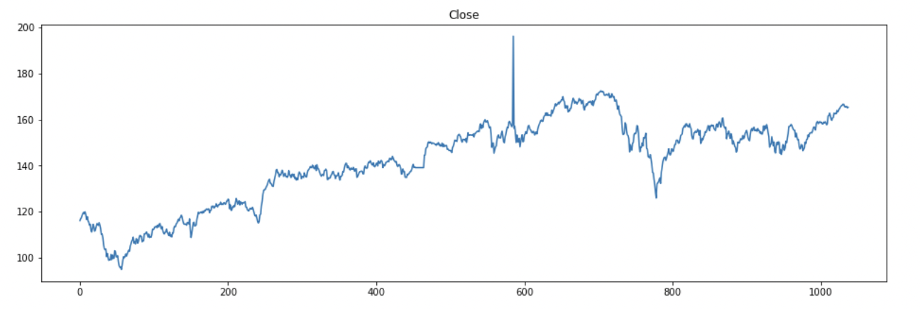
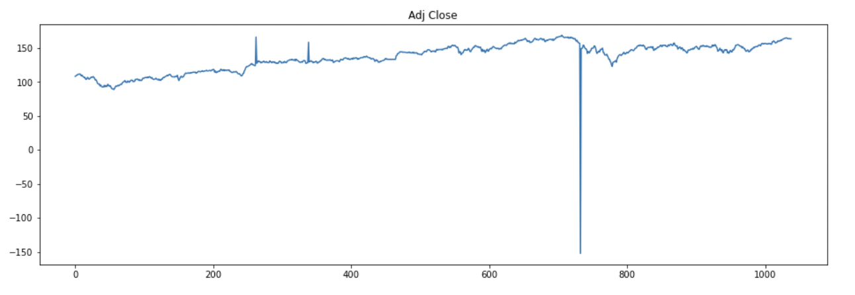
Data Preview

Slide 5
Methodology
Rolling Window Sigma Rule
1. Set a window, calculate the mean and standard deviation of the window.
2. Determine if the next point is deviated from the mean for a certain times of standard deviation.
3. If so, replace the outlier with a proposed value, for example, use the former value or use linear interpolation.

Slide 6
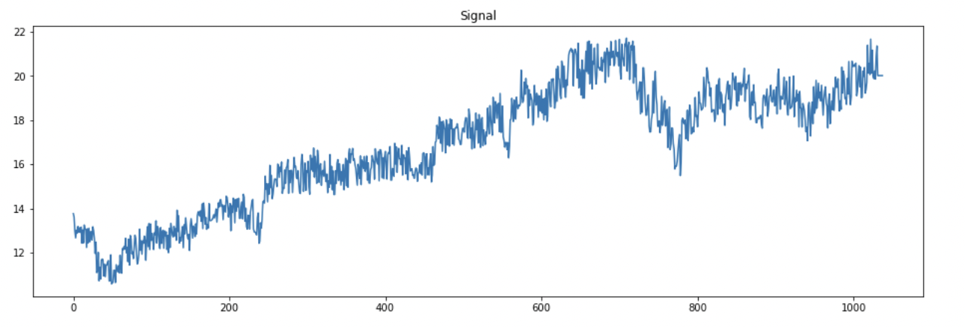
Signal Result

Slide 7
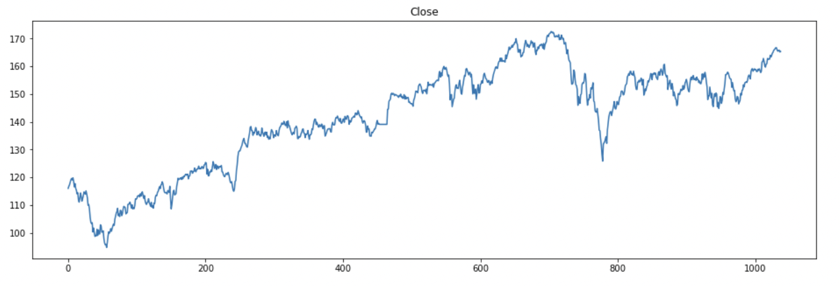
Close Result

Slide 8
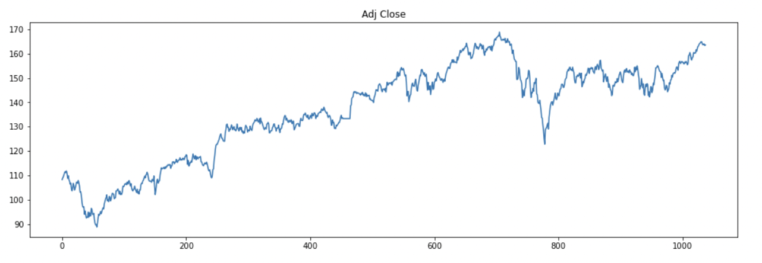
Adj Close Result

Slide 9
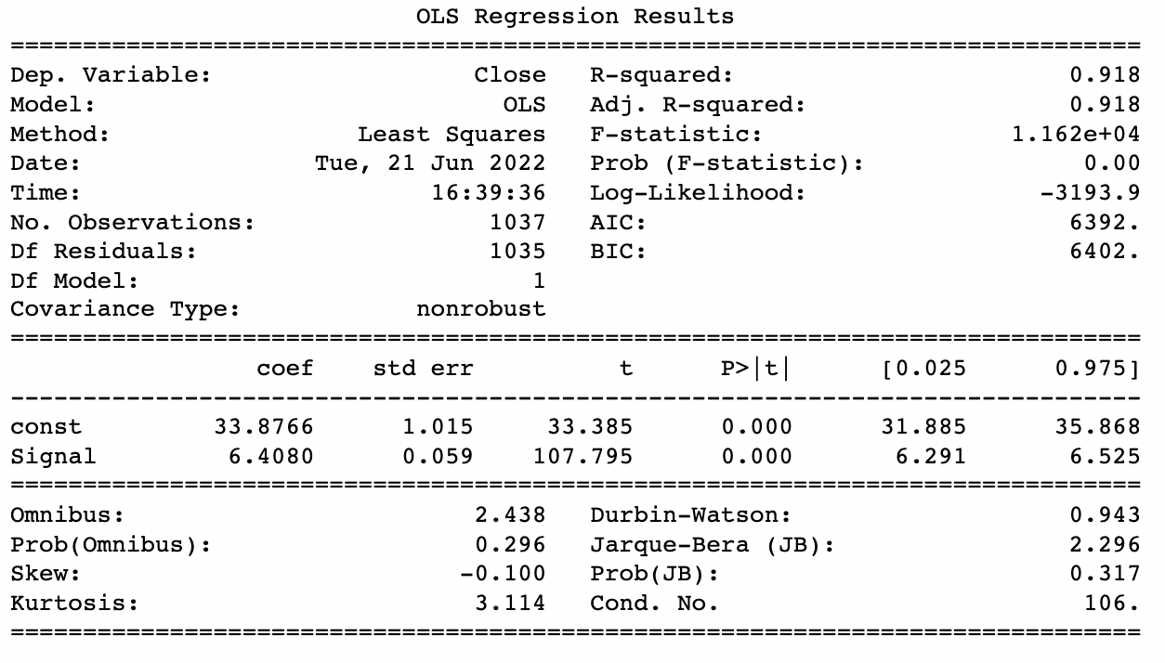
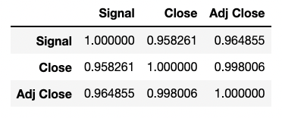
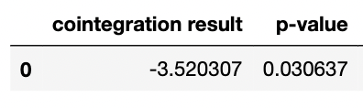
Signal-Close OLS and Cointegration Analysis

Slide 10
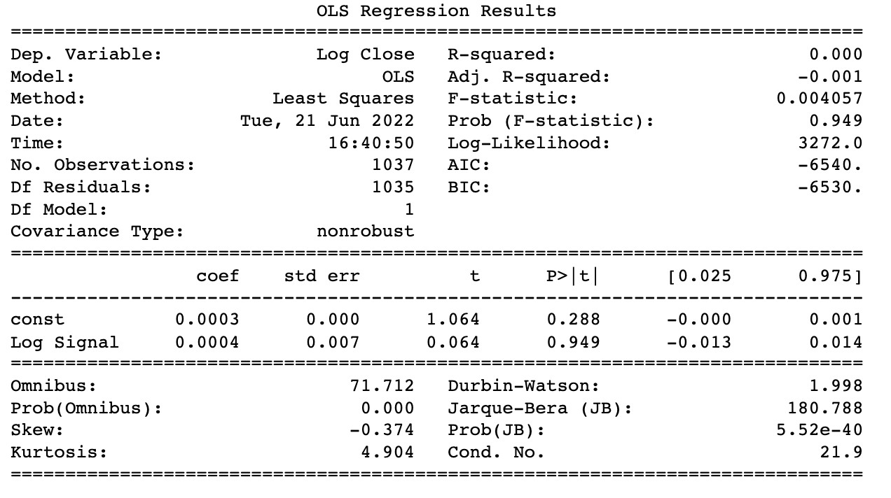
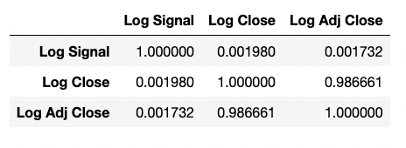
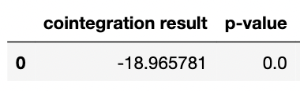
Log Signal-Close OLS and Cointegration Analysis

Slide 11
Project 2

Slide 12
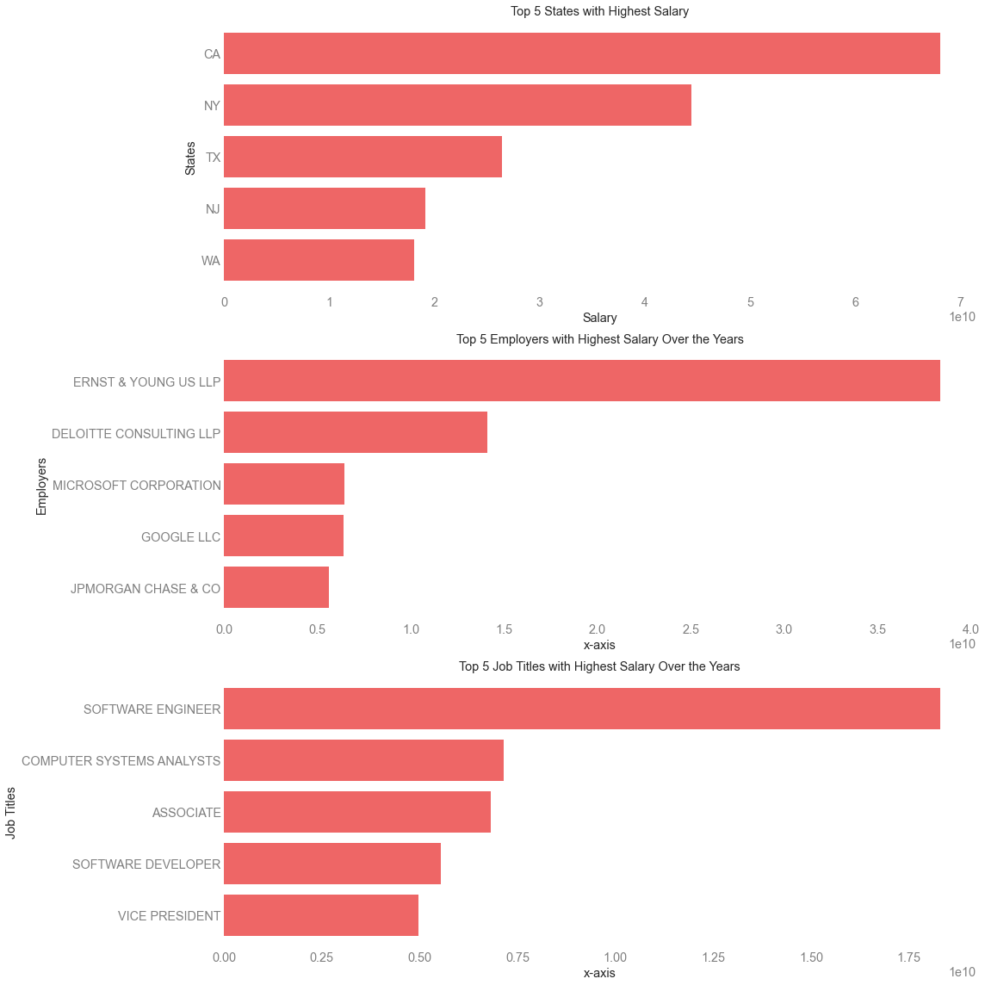
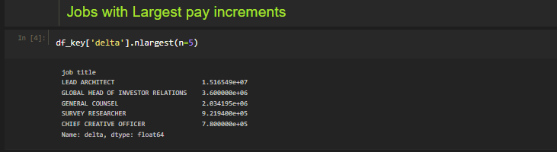
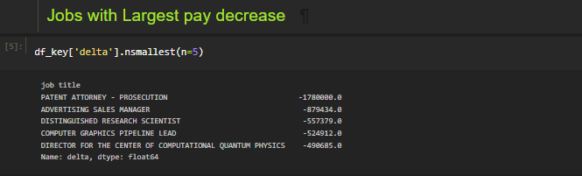
Top 5 Stats

Slide 13
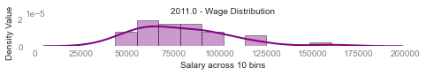
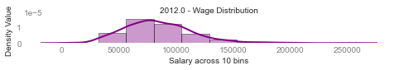
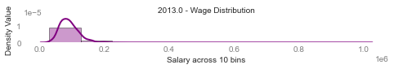
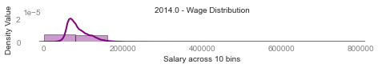
Wage Distribution – Across Years (2011 – 2014)

Slide 14
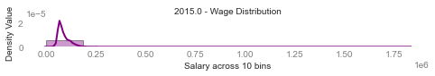
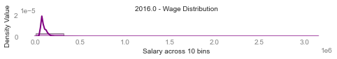
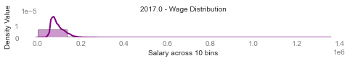
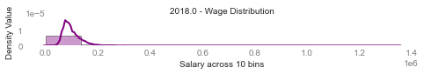
Wage Distribution – Across Years (2015 – 2018)

Slide 15
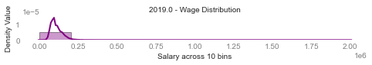
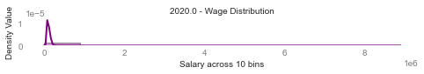
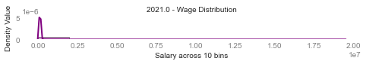

Wage Distribution – Across Years (2019 – 2022)

Slide 16
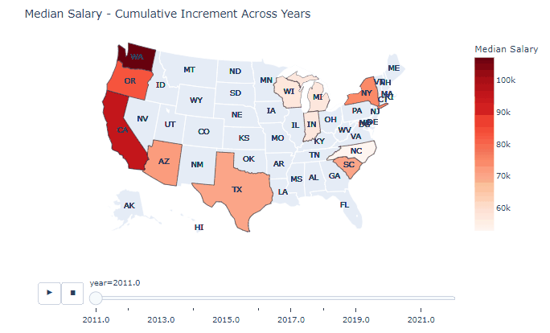
Median Salary – Across Cities – Across Years

Slide 17
Project 3

Slide 18
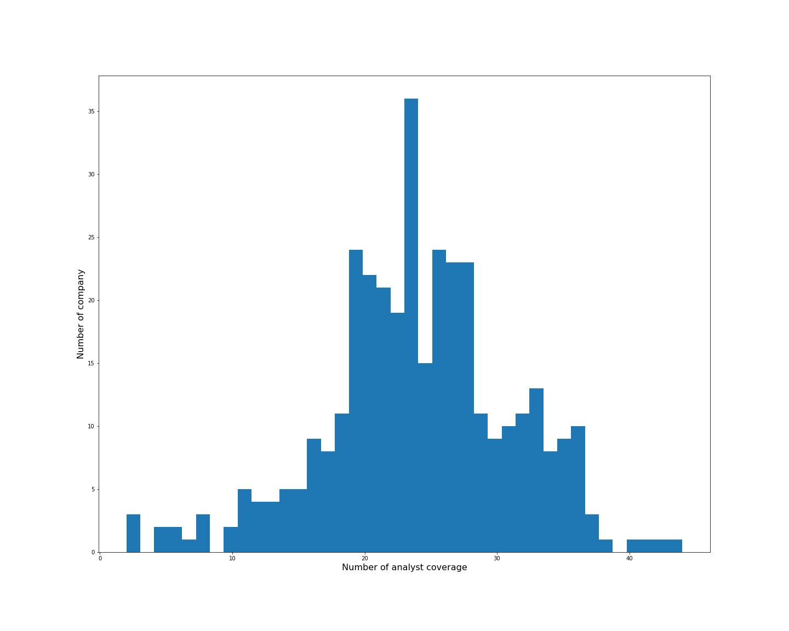

1. Which company has the highest analyst coverage?
The company that has the highest analyst coverage is ADS GR Equity, and the number of analysts is 44.

Slide 19
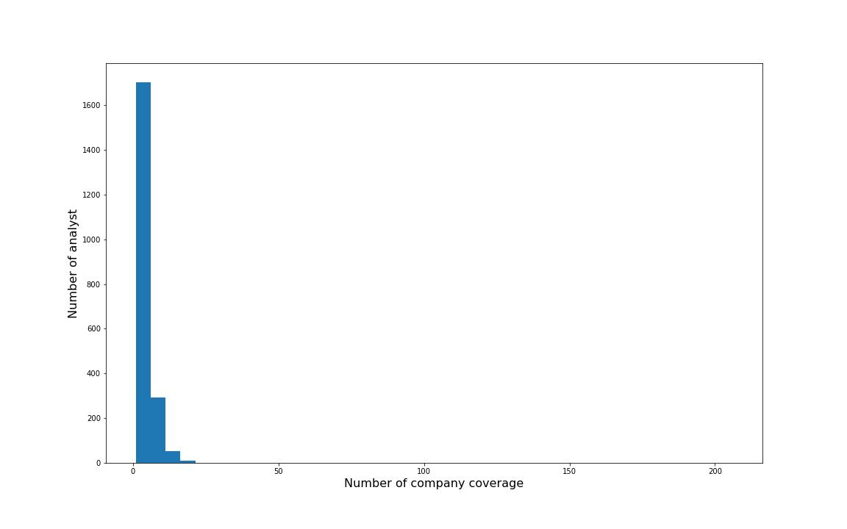
2. Which analyst covers the most companies?
The analyst that covers the most companies is Antpagna, and the number of companies is 206.

Slide 20
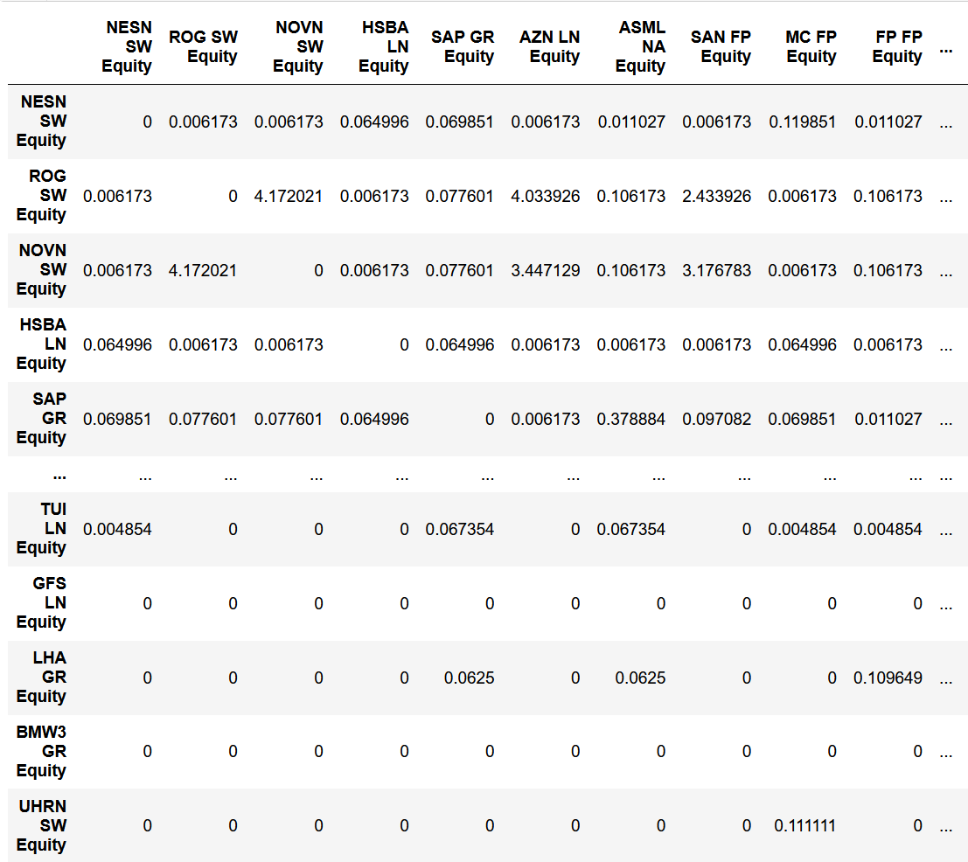
3.1 Similarity Matrix
In this similarity Matrix, we consider all the analysts.
In the next page, we make some restriction on the analysts.

Slide 21
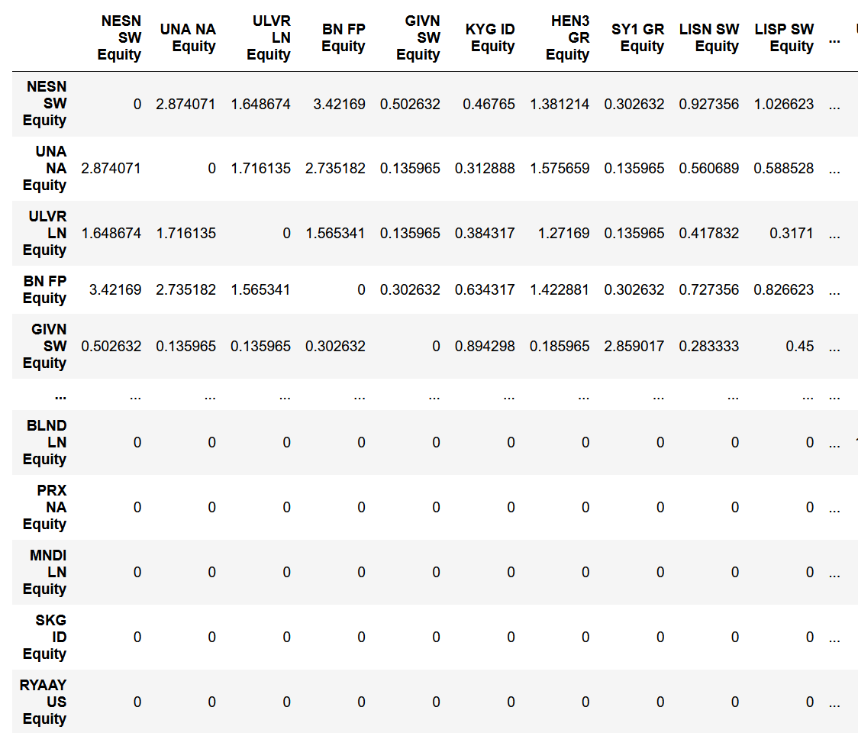
3.2 Restricted to analysts that cover >=3 companies and <=20 companies
In this matrix, we can see that some relationships with small similarity are eliminated, since extreme company coverage is avoided, similarity with largest number and smallest number disappear as well.

Slide 22
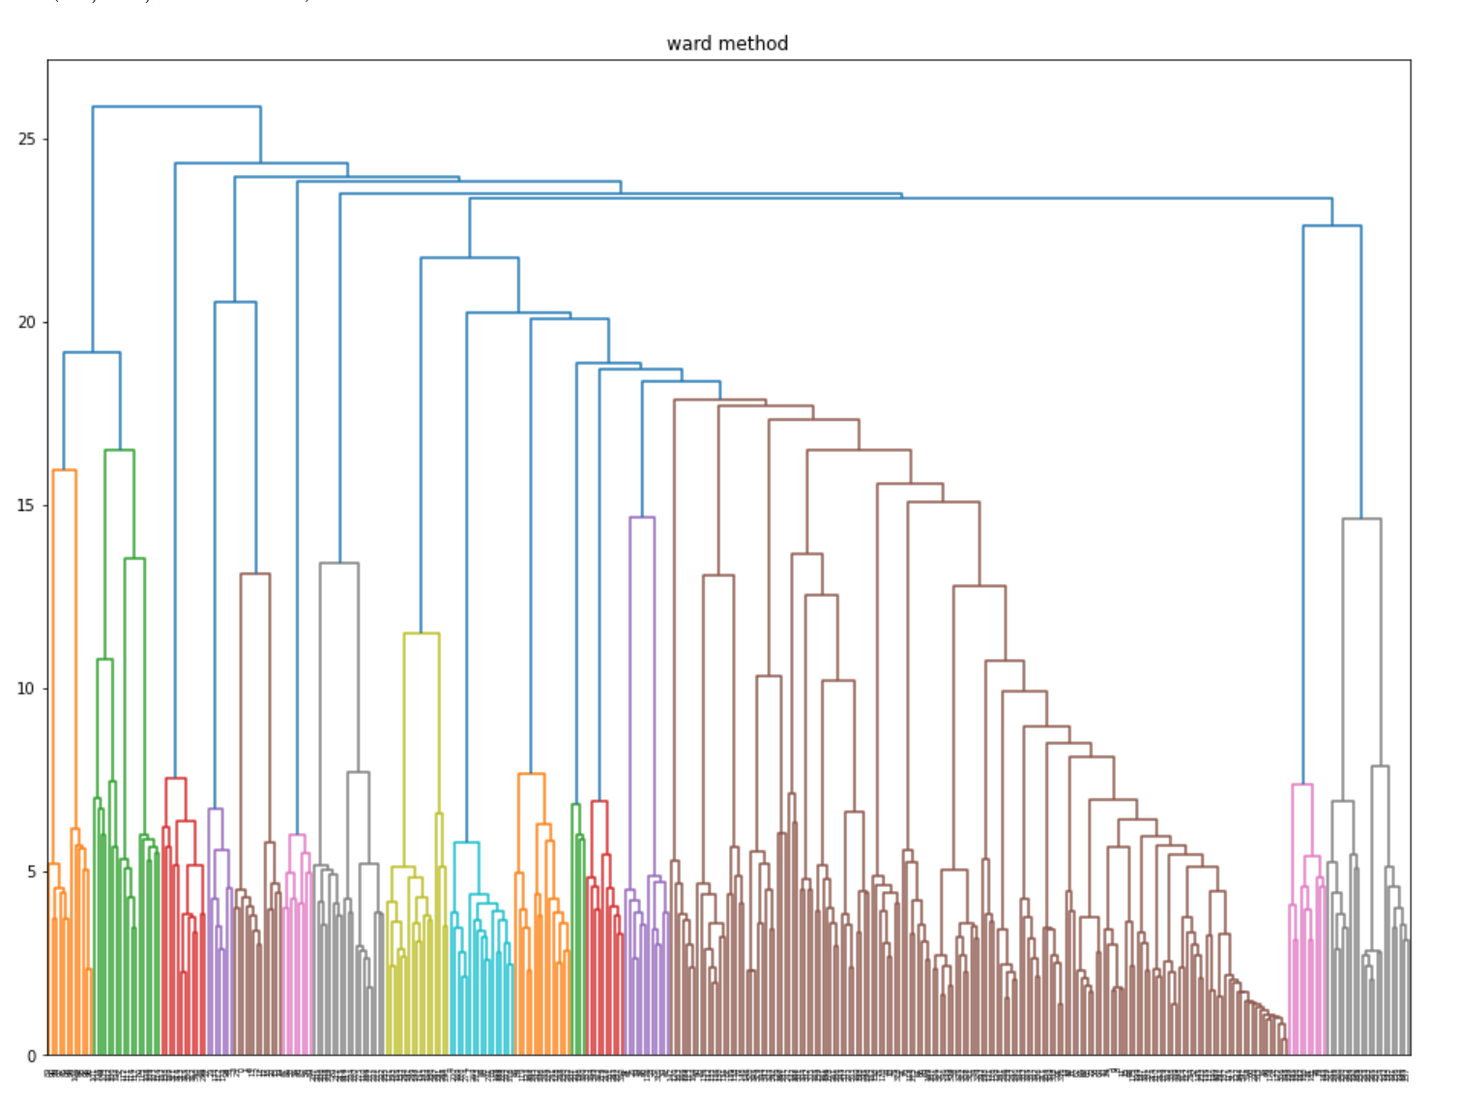
4.Hierarchical
Ward method shows the best result, since it considers each factor in the most balance way.

Slide 23
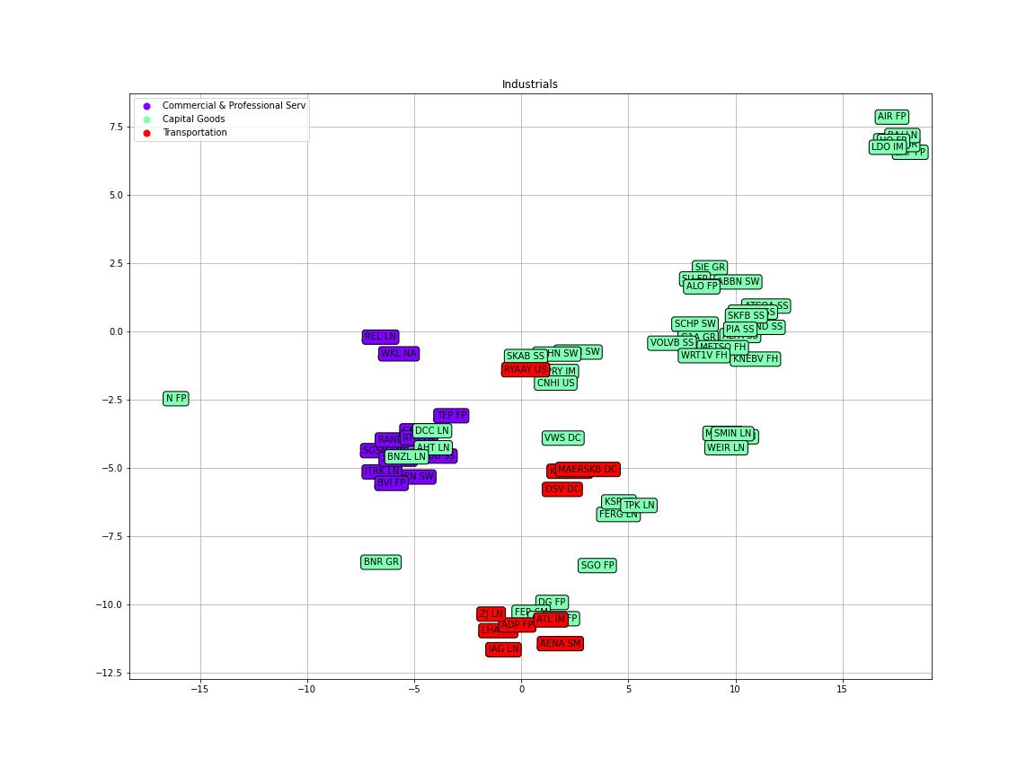
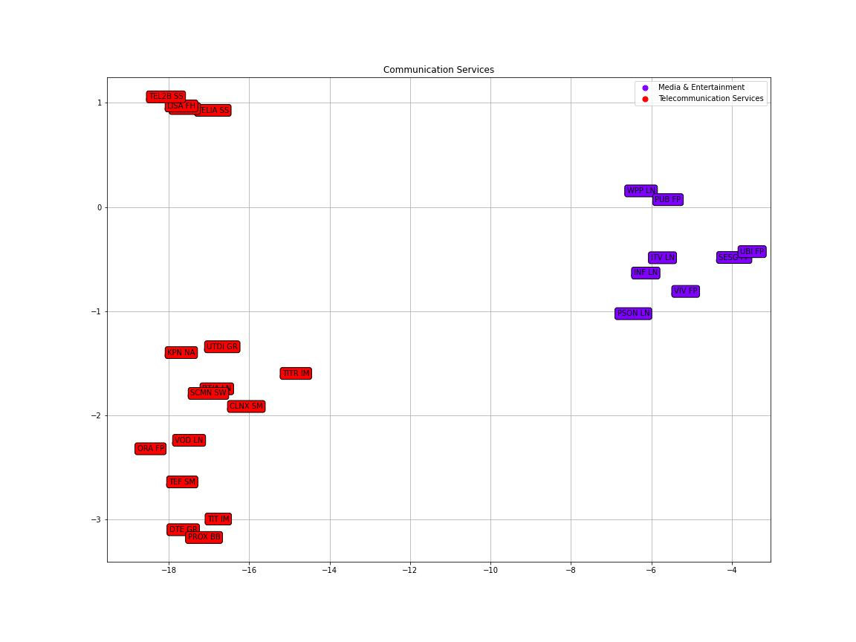
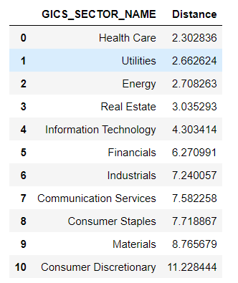
5.Homogeneous and Heterogeneous

Slide 24
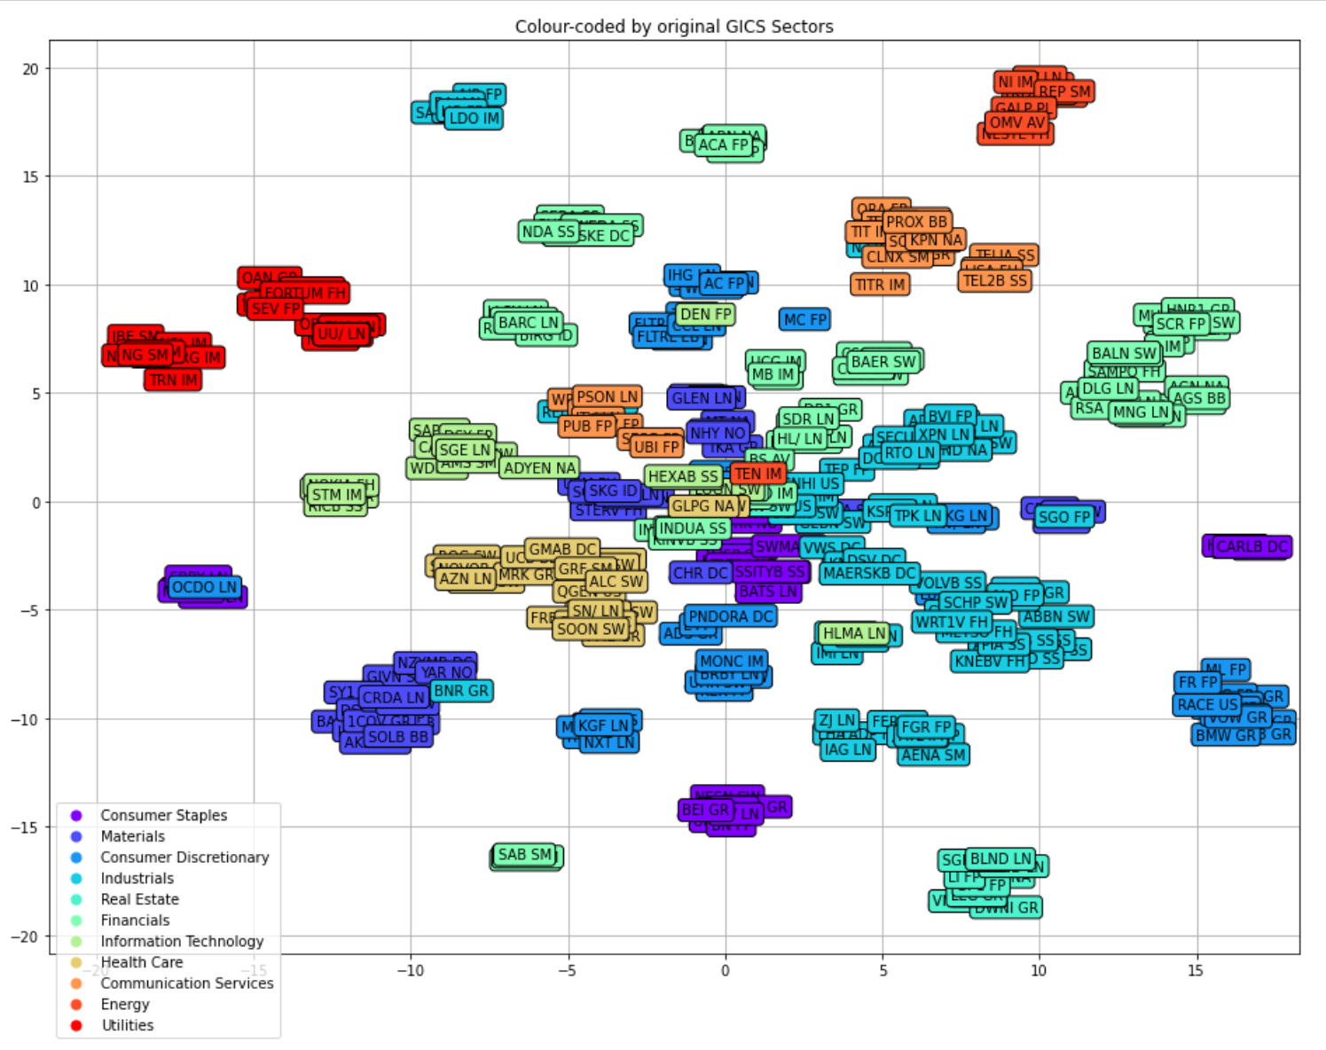
Colored by Sectors

Slide 25
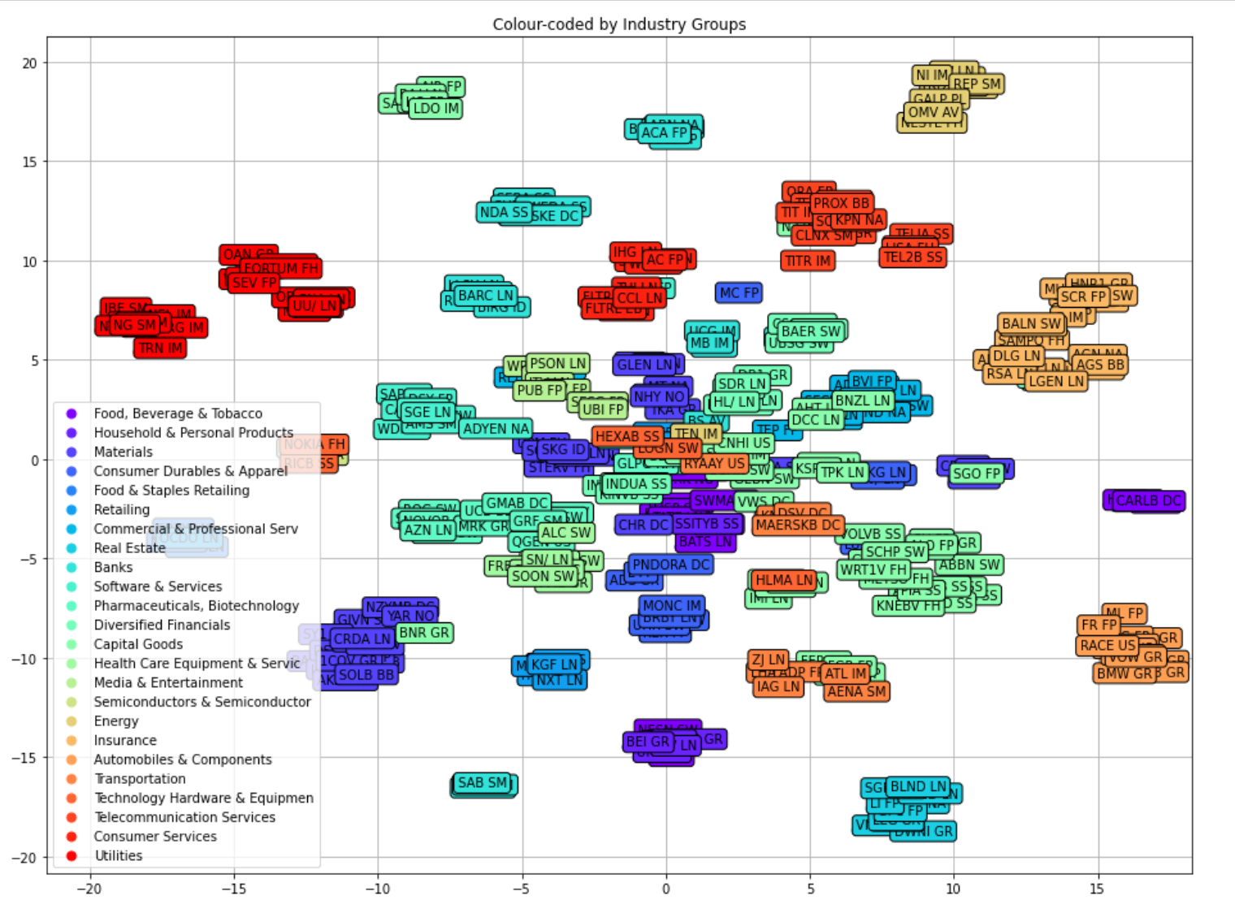
Colored by Industry Groups

Slide 26
Thanks for watching!

